Slide 1
Response predictions at different levels of working memory load
"
Miruna Rusca
Weian Li
Dhananjay Dahiya
Lisa Bastian

Slide 2
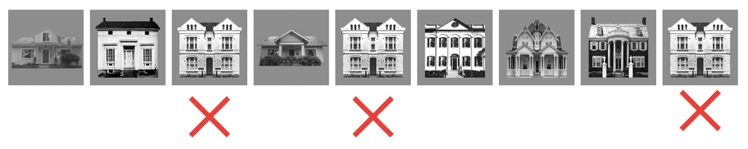
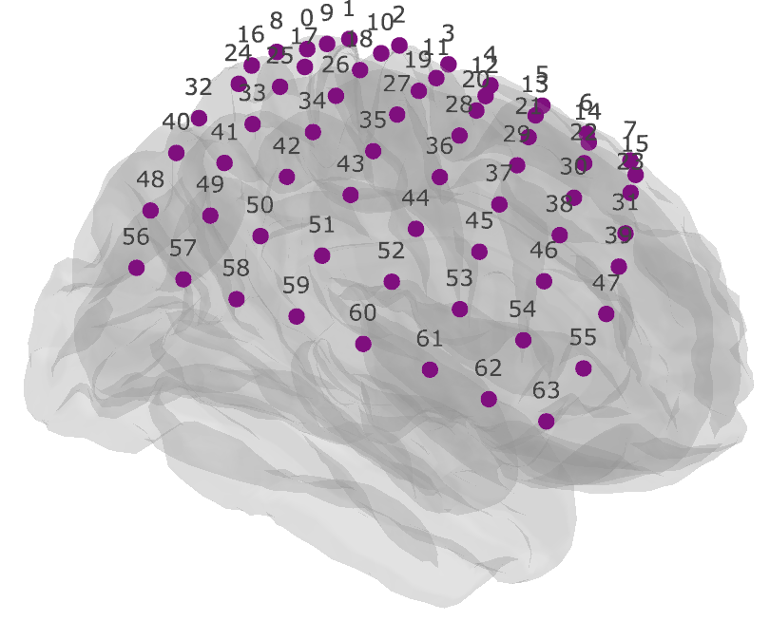
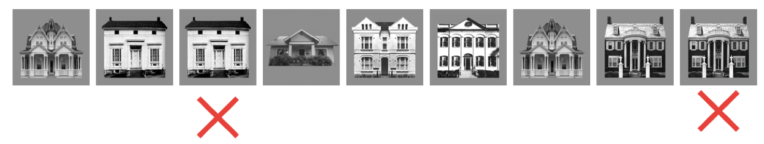
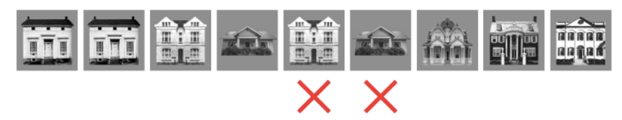
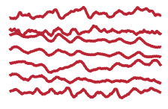
Objectives
The n-back task as a measure of working memory load in epilepsy patients:
0-back
1-back
anterior parietal
→ posterior frontal
ECoG
2-back
Miller ECoG Data
Miruna, Weian, Dhananjay, Lisa

Slide 3
Objectives
The n-back task as a measure of working memory load in epilepsy patients:
Can we classify response and no response trials based on time series and time-frequency features using machine learning algorithms?
How do these different algorithms perform with varying levels of working memory load ?
0-back
1-back
anterior parietal
→ posterior frontal
ECoG
2-back
Miller ECoG Data
Miruna, Weian, Dhananjay, Lisa

Slide 4
Data Exploration
Miller ECoG Data
Miruna, Weian, Dhananjay, Lisa

Slide 5
"Classical" Machine Learning
SVM
KNN
Miller ECoG Data
Miruna, Weian, Dhananjay, Lisa

Slide 6
"Modern" Machine Learning
CNN
Miller ECoG Data
Miruna, Weian, Dhananjay, Lisa

Slide 7
Conclusion
Miller ECoG Data
Miruna, Weian, Dhananjay, Lisa

